Slide 1

ODBC2KML Project Demo
PolyTech Industries, Inc.
April 15, 2010

Slide 2

Agenda
Course Overview
Project Overview
Major Functionality
Technical Design
Interface Design
Project Demo
Questions

Slide 3
Project working structure
Two weekly meetings
Weekly reports
Time
Tasks

Slide 4
Impacts of this course
Real world development experience
Builds teamwork and communication skills
Helps students understand the Software Engineering process

Slide 5
The Team

Slide 6
The Hours

Slide 7
Current Situation
Manual database parsing
On demand
Any database
Time consuming
End result: KML file

Slide 8
Solution
ODBC2KML
Easy to use
Intuitive interface design
Preview KML
Automated KML generation
End result: KML file

Slide 9
Project Overview
Connect to a database
Map database field(s) to KML field(s)
Latitude/Longitude
Placemark Name
Insert Field Values into Description
Generate KML

Slide 10
Major Functionality
Create Connection
Edit Connection
Delete Connection
Generate KML File
Web Service
Web Application
Preview KML in browser by Google Earth Plugin

Slide 11
Technologies
ASP.NET 2.0
C#.NET
JavaScript/Ajax
Microsoft SQL Server Database

Slide 12
Google Integration
Google Code
Wiki
Bug tracker
Version control
Google Earth

Slide 13
Technical Design
Core ODBC2KML classes
ODBC Database Connections
Public facing Web Pages
KML Generation Web Service

Slide 14
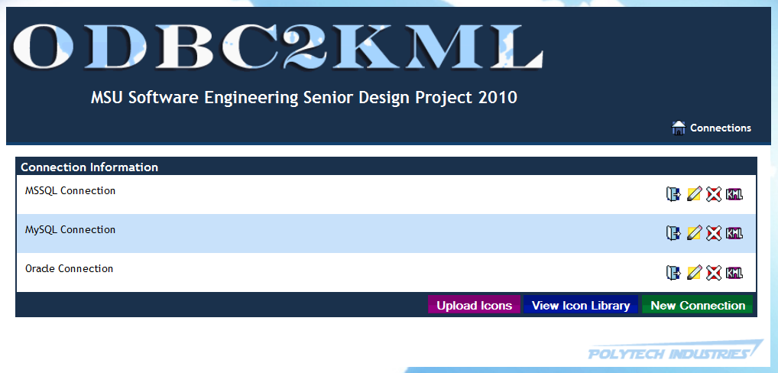
Design – Main Page

Slide 15
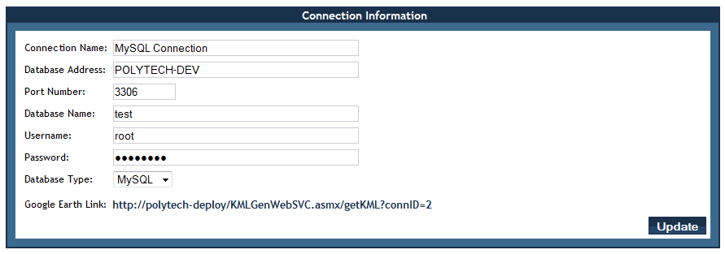
Design – ConnDetails: ConnInfo

Slide 16
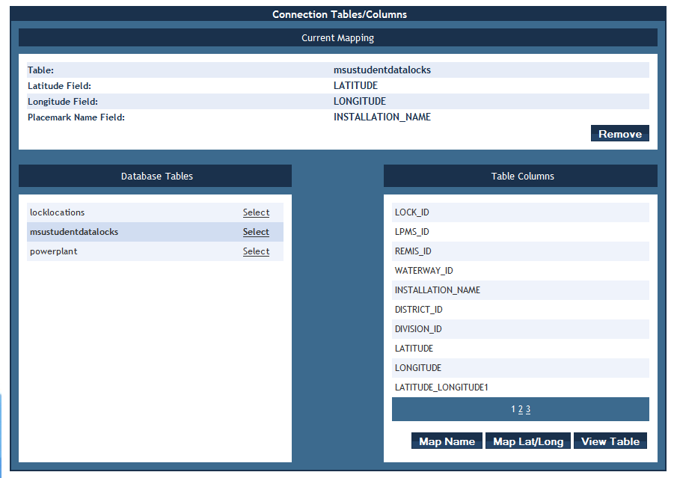
Design – ConnDetails: Mapping

Slide 17
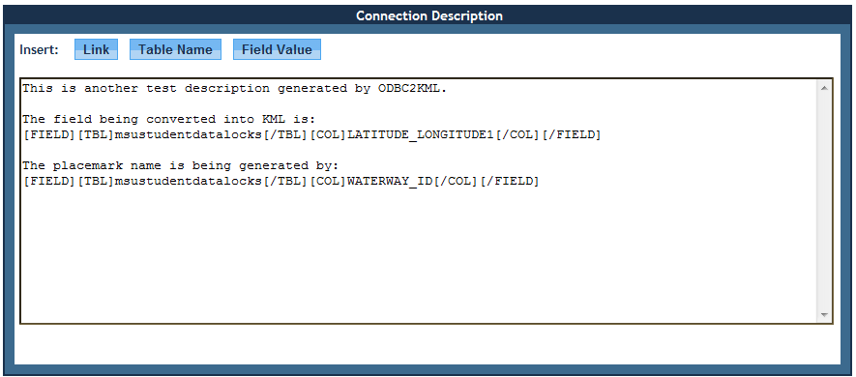
Design - ConnDetails: Description

Slide 18
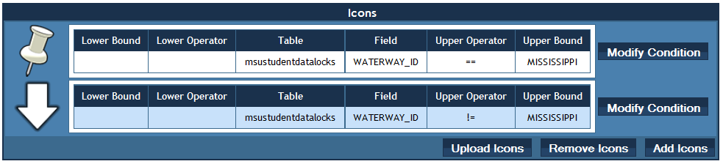
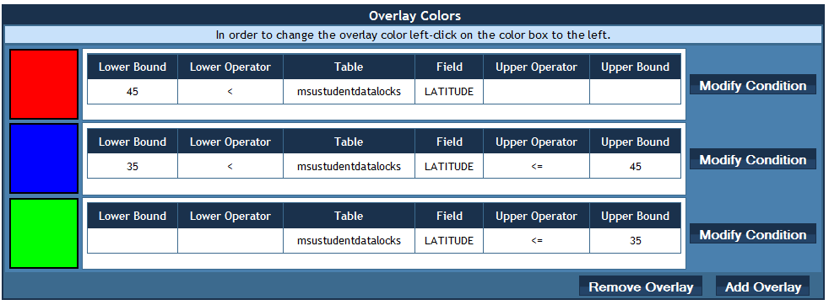
Design – ConnDetails: Icons and Overlays

Slide 19
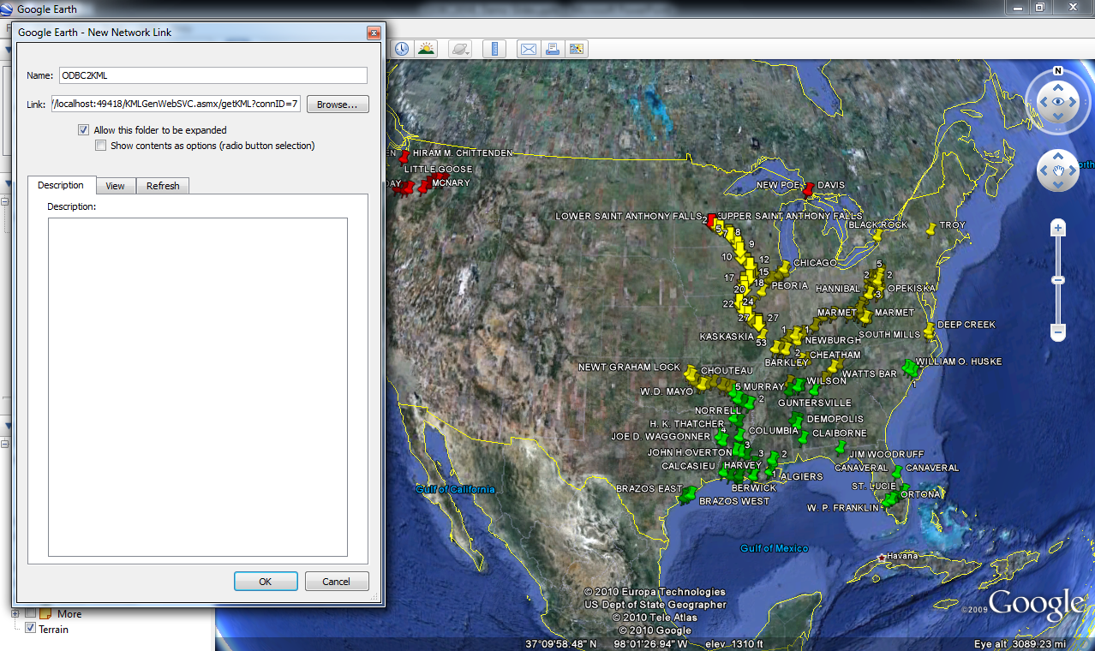
Design - KMLGenWebSVC

Slide 20
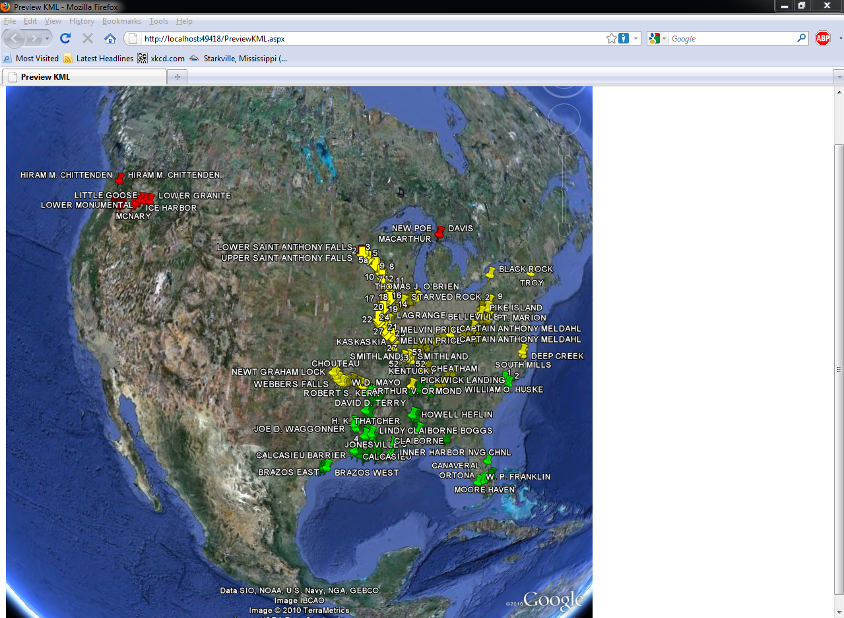
Design – Preview KML

Slide 21
Demo Hardware Setup
ODBC2KML in VM
Client Laptop
Remote Data Source in VM

Slide 22
Demo

Slide 23
Perfective Maintenance
CallBacks instead of PostBacks
More JavaScript
Implement more ODBC Databases
Map more KML Fields
Map multiple tables per connection
Image generation web service
Change default view in KML

Slide 24
Questions?

